Slide 1
Statistics
Foundation to analytics

Slide 2
Statistics….Why?
What is Statistics?
Why use Statistics?
Statistics is a range of procedures for gathering, organizing, analyzing, presenting and making inference from the data.
Descriptive stat.
Includes collecting, organizing,
summarising, analysing,
and presenting data
Inferential stat.
Includes making inferences,
hypothesis testing, determining relationship,
and making prediction
A marketing director, of company ABC wants to know if the new marketing campaigns in the last quarter have been successful or not. Is the lift in revenue solely due to marketing effectiveness?
A division vice president of a retail company wants to understand the return on investment from sending out newspaper inserts to its loyal customers. Is the increase in sales significant or is it purely due to economic growth?
A clinical scientist wants to understand the effectiveness of a drug in pre – clinical trials (clinical trials where the drug is administered on animals in the laboratory). Are the results promising enough to test the drug on human beings? Are there any chances of side effects?

Slide 3
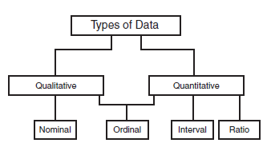
Variable Types
Quantitative variables are anything that can be expressed as a number, or quantified. Examples of quantitative data are scores on achievement tests, number of hours of study, or weight of a subject.
Qualitative variables data cannot be expressed as a number. Data that represent nominal scales such as gender, socieo economic status, religious preference are usually considered to be qualitative data.
Nominal variables allow for only qualitative classification. That is, they can be measured only in terms of whether the individual items belong to some distinctively different categories, but we cannot quantify or even rank order those categories. Typical examples of nominal variables are gender, race, color, city, etc.
Ordinal variables allow us to rank order the items we measure in terms of which has less and which has more of the quality represented by the variable, but still they do not allow us to say "how much more.” Ordinal data can be either qualitative or quantitative. An example of quantitative data is rating movies with 1, 2, 3, or 4 stars.
Interval variables allow us not only to rank order the items that are measured, but also to quantify and compare the sizes of differences between them. For example, temperature, as measured in degrees Fahrenheit or Celsius, constitutes an interval scale. For instance, 70 degrees is 5 degrees warmer than 65 degrees.
Ratio variables are very similar to interval variables; in addition to all the properties of interval variables, they feature an identifiable absolute zero point, thus they allow for statements such as x is two times more than y. Typical examples of ratio scales are measures of time or space. Examples of this type of data are age, weight and salary

Slide 4

Understanding the scale of measurement for each variable
Variable | Values | Scale
Jersey Numbers | 189, 222, 125 | Nominal
Position in race | 1st, 2nd, 3rd | Ordinal
Performance Rating (scale 1 – 10) | 8.3, 7.9, 6.9 | Interval
Time taken to complete the race | 24.5 min, 25.4 min, 25.6 min | Ratio
Scale | Basic Characteristics | Examples | Permissible Statistics Descriptive
Nominal | Numbers identify & classify objects | Social Security nos., Numbering of football players Brands, store types | Mode
Ordinal | Nos. indicate the relative positions of objects but not the magnitude of differences between them | Quality rankings, Rankings of teams in a tournament Preference rankings, Market position, Social class | Percentile, Median
Interval | Differences between objects can be compared, Zero point is arbitrary Also called a rating scale | Température (Fahrenheit, Celsius) Préférence ratings Attitudes, opinions, index nos. | Range, Mean, Standard Deviation
Ratio | Zero point is fixed, Ratios of scale values can be compared | Length, weight,Age, sales, income, costs | Range, Mean, Standard Deviation

Slide 5
Quantitative Analysis : Univariates and Bi-variates
Types of Analysis
Univariate Analysis
The analysis of a single variable, for purposes of description (examples: frequency distribution, averages, and measures of dispersion).
Weapons: Mean , Median , Mode, Percentiles , Standard Deviation
Application : To understand the behavior of a certain variable
Bivariate Analysis
The analysis of two variables simultaneously, for the purpose of determine the empirical relationship between them.
Weapons: Tests of Statistical Significance , Chi – Square
Application : To understand the impact of a given variable on the dependent variable
Multivariate Analysis
The analysis of multiple variables simultaneously, for the purpose of determine the empirical relationship between them.
Weapons: Ordinary Least Square regression, Path Analysis, Time Series Analysis, Factor Analysis , Analysis of Variance ( ANOVA)
Application : Predicting the Sales of a store, Attrition of a customer, impact of an Advertisement on the revenue etc.
Measures of location indicate where on the number line the data are to be found. Common measures of location are:
(i) the Arithmetic Mean,
(ii) the Median, and
(iii) the Mode

Slide 6
Univariate Analysis : Measures of Central Tendency
Measures of central tendency describe the center point of a data set with a single value.
Example: The systolic blood pressure of seven middle aged men were as follows:
(151, 140,140, 130, 124,132,151,124, 132, 170, 146, 124 and 113)
Mean : An average computed by summing the values of several observations and dividing by the number of observations
Mean is :
Median : An average representing the value of the “middle” case in a rank-ordered set of observations
Medium is : 132
Mode : An average representing the most frequently observed value or attribute
Mode is : 124

Slide 7



Univariate Analysis : Measures of Dispersion
Measures of dispersion describe how far individual data values have deviated from the mean
Example: The attrition of employees every month in a company “ABC”:
(7,9,8,11,4)
Range : It is calculated by finding the difference between the highest value and the lowest value in the data set.
Range is : (11-5) = 7
Variance: The variance is a measure of dispersion that describes the relative distance between the data points in the set and the mean of the data set.
Variance is : 6.7
Standard Deviation : A standard deviation is the square root of a variance
Std Dev is : 2.6 Employees

Slide 8
Bivariate analysis

Slide 9
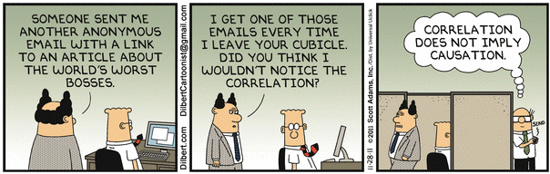
In a Gallup poll, surveyors asked, “Do you believe correlation implies causation?’”
64% of American’s answered “Yes” .
38% replied “No”.
The other 8% were undecided.
In “Desi” Terms
India loses every time I don’t wear my lucky underpants
Eating Chow-Mein causes Rape
The more TV you watch, the lower your IQ will be

Slide 10
Correlation
Correlation
Correlation, as a statistical term, is the extent to which two numerical variables have a linear relationship
Correlation tells us two variables (X) and (Y) are related
Types of relationship reflected in correlation
X causes Y or Y causes X (causal relationship)
X and Y are caused by a third variable Z (spurious relationship)

Slide 11
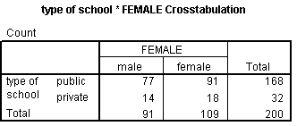
Chi-Square test of independence
Assumptions
The sampling method is simple random sampling
The variables under study are each categorical
If sample data are displayed in a contingency table, the expected frequency count for each cell of the table is at least 5
Contingency Table:
Hypotheses
H₀: Variable A and Variable B are independent. H_{a}: Variable A and Variable B are not independent
Interpreting results: If p-value is less than significance level, there is an association between Variable A and Variable B

Slide 12

ANOVA
What if we have to test for means of more than 2 samples?
Run Multiple t tests (for 3 groups – 3 tests, 4 groups – 6 tests, 5 group – 10 tests and so on)
Time consuming
Increased error (confidence levels goes down rapidly)
Use ANOVA
It tests the null hypothesis:
Significant result – fail to reject null – atleast two groups have different means
Limitation – can not tell you which two groups have different means
Still need to run t-test to find out the groups
Very easy to perform in excel using Data Analysis tool
http://www.excel-easy.com/examples/anova.html

Slide 13
Example 3
Three groups of samples of factory emissions of different plants of the same company were collected. The score is computed based on the composition of the emissions. We want to find out if there is any inconsistency or difference across the three groups.
A = 57,56,58,58,56,59,56,55,53,54,53,42,44,34,54,54,34,64,84,24
B = 49,47,49,47,49,47,49,46,45,46,41,42,41,42,42,42,14,14,34
C = 49,48,46,46,49,46,45,55,61,45,45,45,49,54,44,74,54,84,39

Slide 14
Hypothesis of One-Way ANOVA
µ₁ = µ₂ = µ₃ = µ₄ = …= µ_{k}
Not all of the population means are equal
For at least one pair, the population means are unequal.

Slide 15
Dof(between) = k – 1 = 3 – 1 = 2
Dof(within) = N – k = 59 – 3 = 56
Dof(total) = 56 + 2 = 58
For the above degrees of freedom,
$F_{critical}$ = 3.161
Mean(A) = 52.45
Mean(B) = 41.36
Mean(C) = 51.45
Overall Mean = 2864/59 = 48.54

Slide 16

Contd..
$F_{statistic}$ = 5.73
$F_{statistic}$ > $F_{critical}$
Since our f-statistic is beyond the critical value, samples are different.

Slide 17
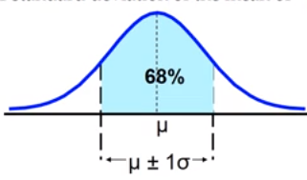
The Empirical rule
The empirical rule approximates the variation of data in a bell-shaped distribution.
Approximately 68% of the data in a bell shaped distribution is within 1 standard deviation of the mean.

Slide 18
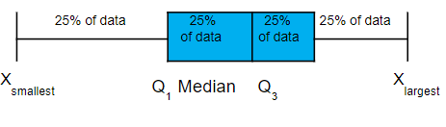
Boxplot: A Graphical display of the data based on the five-number summary:
Example:

Slide 19
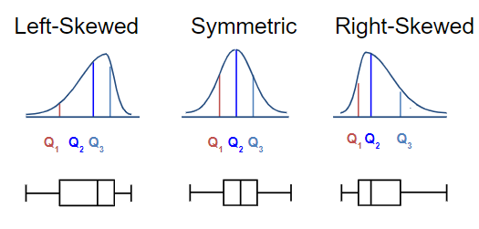
Distribution Shape and
The Boxplot

Slide 20
Graphic Displays of Basic Statistical Descriptions
Boxplot: graphic display of five-number summary
Histogram: x-axis are values, y-axis repres. frequencies
Quantile plot: each value x_{i} is paired with f_{i} indicating that approximately 100 f_{i} % of data are ≤ x_{i}
Scatter plot: each pair of values is a pair of coordinates and plotted as points in the plane

Slide 21
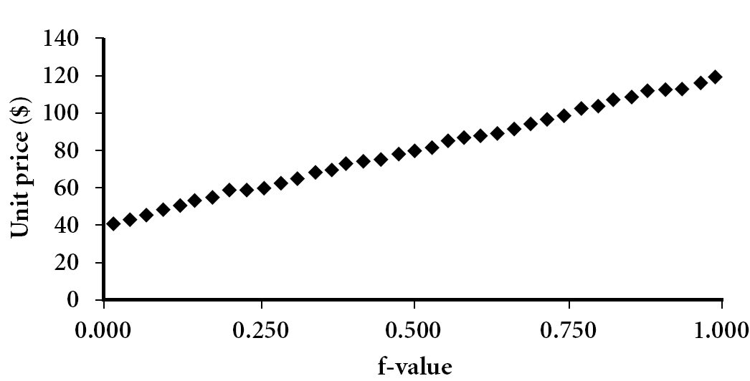
Quantile Plot
Displays all of the data (allowing the user to assess both the overall behavior and unusual occurrences)
Plots quantile information
For a data x_{i} data sorted in increasing order, f_{i} indicates that approximately 100 f_{i}% of the data are below or equal to the value x_{i}

Slide 22
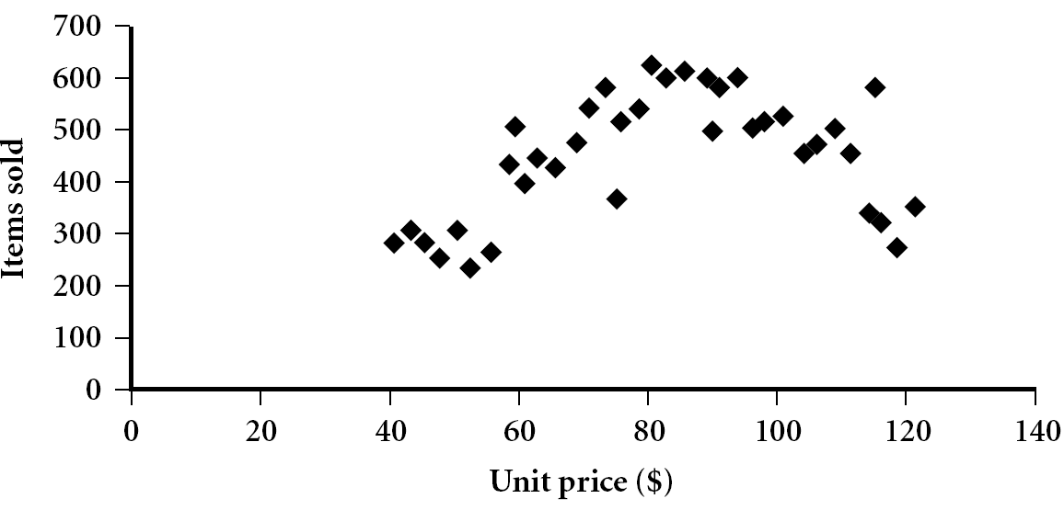
Scatter plot
Provides a first look at bivariate data to see clusters of points, outliers, etc
Each pair of values is treated as a pair of coordinates and plotted as points in the plane

Slide 23
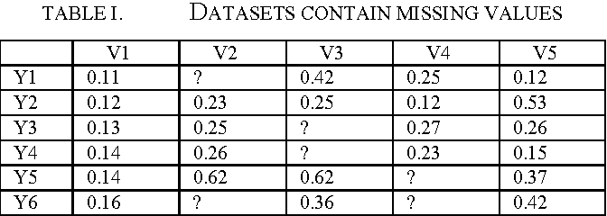
Missing Data
In statistics, missing data, or missing values, occur when no data value is stored for the variable in an observation. Missing data are a common occurrence and can have a significant effect on the conclusions that can be drawn from the data
Treating missing values:
Imputation – Replacing with mean, median or mode
Remove – Remove the observations

Slide 24
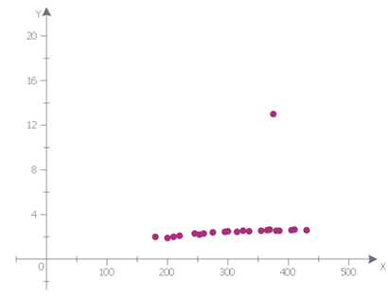
Outlier treatment
Following are the different ways to detect outliers –
Quantiles
Box plot
Extreme Value Analysis using z test
Treating Outliers –
Imputation - Replacing with mean, median or mode
Capping - Replacing with Xth percentile (Usually 99th percentile)
Remove - Remove the observations

Slide 25
Visualization

Slide 26
Tables and Graphs : Why use them?
Communicate complex information concisely and powerfully
Create a “picture” for reasoning about and analyzing quantitative and conceptual information
Makes cognitive processing easier
Provides “content/information rich” view at a glance
Directs attention toward the content rather than methodology
Describe, explore, summarize a set of numbers
Convey a message about the significance of the data

Slide 27
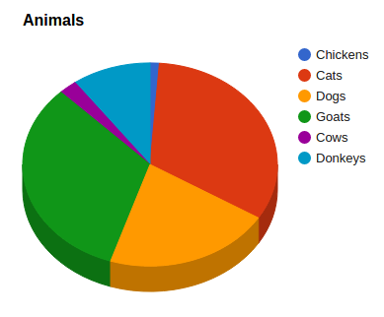
Getting the right picture : Charts and Graphs
Pie Chart
A Pie Chart takes categorical data and breaks them down by group, showing the percentage of individuals that fall into each group
Each individual in the group falls into one and only one category hence the sum of all the slices of the pie should be 100%
Pie charts often do not show the total number in each group, in terms of original units which results in loss of information
Bar Chart
A Bar Chart breaks down categorical data by group and represents metrics with rectangular bars with lengths proportional to the values they represent
Bar diagrams allows comparison over time. E.g., revenue from sales in successive fiscal years
There are other forms bar charts like sub divided bar diagrams and multiple bar diagrams both of which can display additional dimensions and their metrics

Slide 28
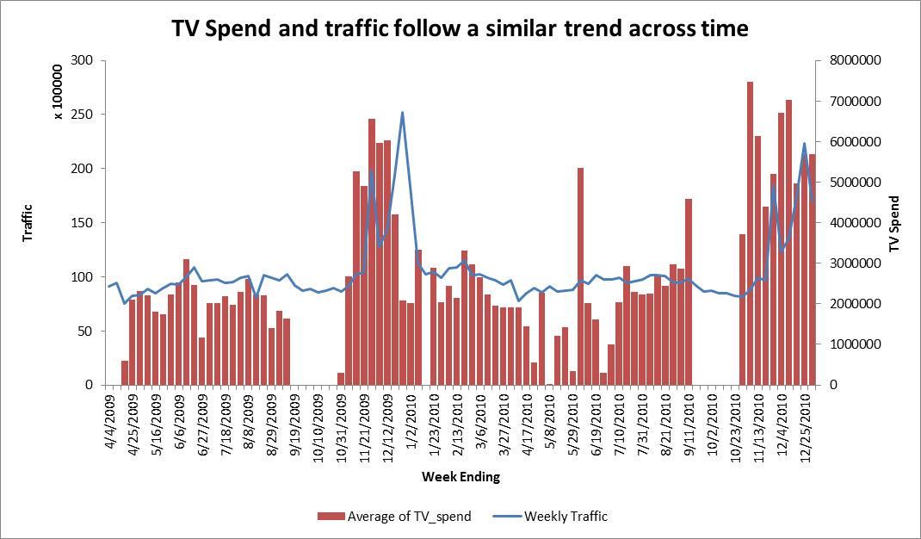
Getting the right picture : Charts and Graphs
Line Chart
A Line Chart (sometimes referred to as Time Chart) examines trend over time.
The horizontal axis of a line chart needs be some unit of time (such as year, month, day etc.)
At each time period the amount is represented by a dot and the dots are connected to form the line chart
Lag Effect

Slide 29
Getting the right picture : Charts and Graphs
Histogram
A Histogram is a graphical representation of the frequency distribution of a continuous variable
In a histogram, frequencies are displayed as rectangles with height of each rectangle proportional to frequency and the width proportional to the interval
However if the widths of the intervals are unequal, then the area of the rectangle rather than the height should be proportional to the frequency

